Slide 1
Chapter 20 Transactions

Slide 2
- Introduction to Transaction Processing - Transaction and System Concepts - Desirable Properties of Transactions - Characterizing Schedules Based on Recoverability
Content

Slide 3
Introduction to Transaction Processing
Transaction:
a logical unit of database processing that must be completed in its entirety to ensure correctness. i.e., transaction atomicity.
A transaction includes database commands such as retrievals, insertions, deletions, and updates.

Slide 4
Introduction to Transaction Processing
Transaction processing systems:
systems with large databases and hundreds of concurrent users.
Examples:
airline reservations,
Banking applications,
credit card processing,
online retail purchasing,
stock markets,
supermarket checkouts etc.
These systems require high availability and fast response time for hundreds of concurrent users.

Slide 5
Introduction to Transaction Processing
Single-User versus Multiuser Systems
One criterion for classifying a database system is the number of users who can use the system concurrently.
Single-user: one user at a time can use the system,
Single-user DBMSs are mostly restricted to personal computer systems
Multiuser: many users can use the system and hence access the database concurrently.
most DBMSs are multiuser.

Slide 6
Introduction to Transaction Processing
Single-User versus Multiuser Systems
A single CPU can execute at most 1 process at a time
But a Multiprogramming OS allows that a processor can:
execute some commands from one process,
then suspend that process
and execute some commands from the next process, and so on.
A process is resumed at the point where it was suspended.

Slide 7
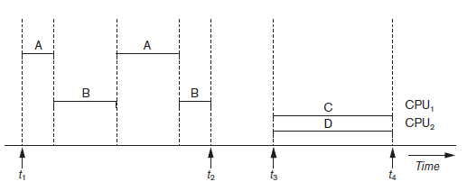
Introduction to Transaction Processing
Single-User versus Multiuser Systems
So, Concurrent execution of processes is actually interleaved,
which shows two processes, A and B, executing concurrently in an interleaved fashion.
Interleaving keeps the CPU busy
For example:
when a process requires an input or output (I/O) operation, such as reading a block from disk.
The CPU is switched to execute another process rather than remaining idle during I/O time.
Interleaving also avoid delays in other process experienced because of execution of a long process.
The diagram represents the
difference between multi programming
and parallel programming.
We will discuss w.r.t
multiprogramming in OS
where database operations are
interleaved

Slide 8
Introduction to Transaction Processing
Transactions, Database Items, Read and Write Operations, and DBMS Buffers
The DB operations that forms a transaction
can be embedded with application program or
they can be specified using SQL commands.
How to mention transaction boundaries?
by specifying explicit begin transaction and end transaction statements in an application program;
in this case, all database access operations between the two are considered as one transaction.
Read Only transaction:
the database operations in a transaction are retrieve operations
Read Write transaction:
the database operations in a transaction are update operations

Slide 9
Introduction to Transaction Processing
Transactions, Database Items, Read and Write Operations, and DBMS Buffers
The size of a data item is called its granularity.
a database record,
Identified by a unique id
a whole disk block,
Identified by an address
an individual field (attribute) value of some record in the database.
The transaction processing concepts are independent of the data item granularity (size).

Slide 10
Introduction to Transaction Processing
Transactions, Database Items, Read and Write Operations, and DBMS Buffers
Since Processor & Disk has a speed mismatch so data is processed and temporarily stored in Main Memory, and after COMMIT it will get saved in disk.
So, The basic database access operations that a transaction can include are:
read_item(X)
Reads a database item named X into a program variable.
To simplify our notation, we assume that the program variable is also named X.
write_item(X)
Writes the value of program variable X into the database item named X.

Slide 11
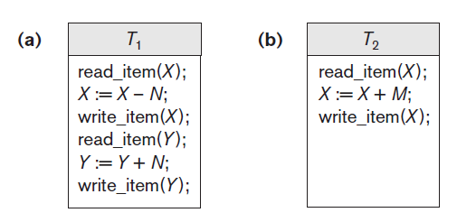
Introduction to Transaction Processing
Transactions, Database Items, Read and Write Operations, and DBMS Buffers
A transaction includes read_item and write_item operations to access and update the database.
The read-set of a transaction is the set of all items that the transaction reads, and the write-set is the set of all items that the transaction writes.
Example: The read-set of T1 is {X, Y} and its write-set is also {X, Y}.

Slide 12
Introduction to Transaction Processing
Transaction Concurrency
Several users using a system can access the data and may try to update it concurrently.
Uncontrolled transaction execution may leads to concurrency anomalies
Which will leave database in an inconsistent state.

Slide 13
Introduction to Transaction Processing
Why Concurrency Control Is Needed?
To address these problems lets take an example of:
Airline Reservation System;
Saves the records of Flights
Each record includes:
the number of reserved seats on that flight as a named (uniquely identifiable) data item, among other information.

Slide 14
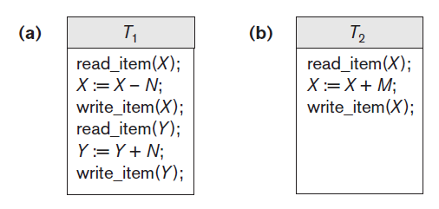
Introduction to Transaction Processing
Why Concurrency Control Is Needed
Transaction T1: (Moving N reservation from Flight 1 to Flight 2)
transfers N reservations from one flight whose number of reserved seats is stored in the database item named X
to another flight whose number of reserved seats is stored in the database item named Y.
Transaction T2 : (Making M reservations in Flight1)
reserves M seats on the first flight (X) referenced in transaction T1.

Slide 15
Introduction to Transaction Processing
Why Concurrency Control Is Needed ?
We will discuss 3 problems here
The lost update problem
The temporary update or the Dirty read problem
The incorrect summary problem
The unrepeatable read problem

Slide 16
Introduction to Transaction Processing
Why Concurrency Control Is Needed
The Lost Update Problem
Occurs when two transactions that access the same database items have their operations interleaved in a way that makes the value of some database items incorrect.
Suppose that transactions T1 and T2 are submitted at approximately the same time,
and suppose that their operations are interleaved then the final value of item X is incorrect
because T2 reads the value of X before T1 changes it in the database, and hence the updated value resulting from T1 is lost.

Slide 17
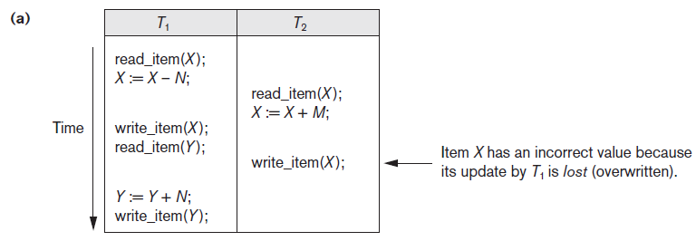
The Lost Update Problem
Let,
X = 80
N=5
M=4
X = 80
M = 4
the final result should be X = 79,
But it is X = 84

Slide 18
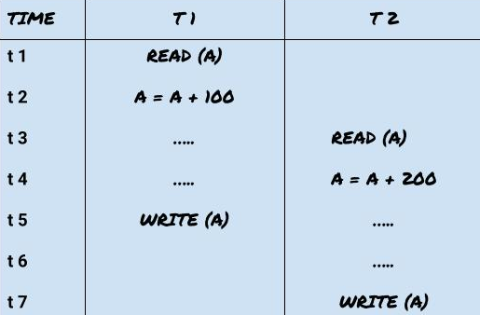
The Lost Update Problem

Slide 19
Introduction to Transaction Processing
Why Concurrency Control Is Needed
The Temporary Update (or Dirty Read) Problem.
This problem occurs when one transaction updates a database item and then the transaction fails for some reason.
Meanwhile, the updated item is accessed (read) by another transaction before it is changed back (or rolled back) to its original value.
Figure 20.3(b) shows an example,
where T1 updates item X and then fails before completion, so the system must roll back X to its original value.
Before it can do so, however, transaction T2 reads the temporary value of X, which will not be recorded permanently in the database because of the failure of T1.
Result:
The value of item X that is read by T2 is called dirty data because it has been created by a transaction that has not completed and committed yet; hence, this problem is also known as the dirty read problem.
This may or may not occur always.

Slide 20
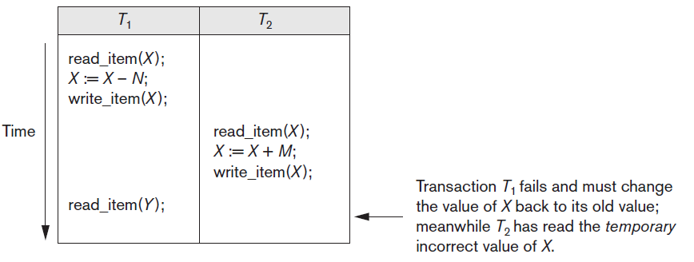
Introduction to Transaction Processing
Why Concurrency Control Is Needed
The Temporary Update (or Dirty Read) Problem.

Slide 21
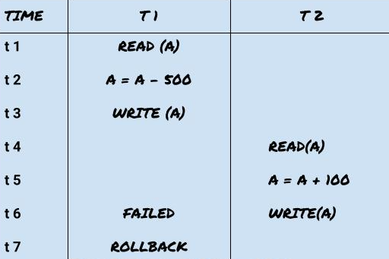
Introduction to Transaction Processing
Why Concurrency Control Is Needed
The Temporary Update (or Dirty Read) Problem.

Slide 22
Introduction to Transaction Processing
Why Concurrency Control Is Needed
The Incorrect Summary Problem.
T1: calculating an aggregate summary function on a number of database items
T2: updating some of these database items,
Problem: the aggregate function may calculate some values before they are updated and others after they are updated.
For example,
suppose that a transaction T3 is calculating the total number of reservations on all the flights;
meanwhile, transaction T1 is executing.
If the interleaving of operations shown in Figure 20.3(c) occurs, the result of T3 will be off by an amount N because T3 reads the value of X after N seats have been subtracted from it but reads the value of Y before those N seats have been added to it.

Slide 23
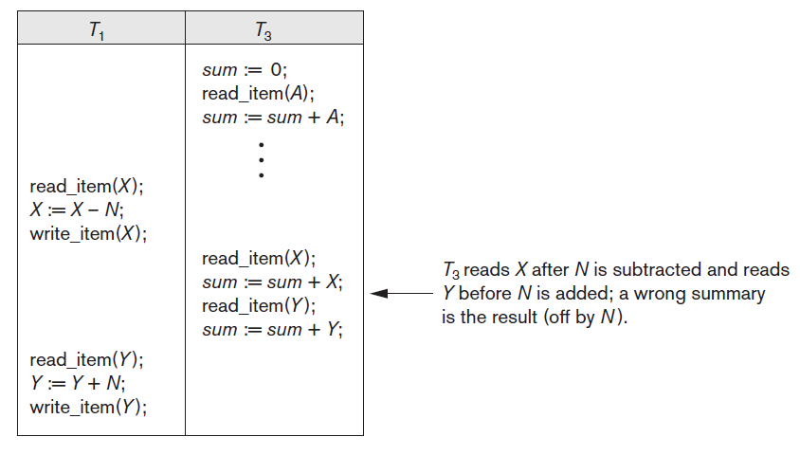
Introduction to Transaction Processing
Why Concurrency Control Is Needed
The Incorrect Summary Problem.

Slide 24
Introduction to Transaction Processing
Why Concurrency Control Is Needed
The Unrepeatable Read Problem.
Problem:
A transaction T reads the same item twice and the item is changed by another transaction T′ between the two reads.
RESULT:
Hence, T receives different values for its two reads of the same item.
for example,
if during an airline reservation transaction, a customer inquires about seat availability on several flights.
When the customer decides on a particular flight, the transaction then reads the number of seats on that flight a second time before completing the reservation, and it may end up reading a different value for the item.

Slide 25
The Phantom Read Problem
Transaction T executes a query that retrieves a set of tuples from a relation satisfying a certain predicate
T re-executes the query at a later time, but finds that the retrieved set contains an additional (phantom) that has been inserted by another transaction in the meantime.
T receives different tuples for the same query
Notes:
Phantoms. A transaction T1 may read a set of rows from a table, perhaps
based on some condition specified in the SQL WHERE-clause. Now suppose
that a transaction T2 inserts a new row r that also satisfies the WHERE-clause
condition used in T1, into the table used by T1. The record r is called a
phantom record because it was not there when T1 starts but is there when
T1 ends. T1 may or may not see the phantom, a row that previously did not
exist. If the equivalent serial order is T1 followed by T2, then the record r
should not be seen; but if it is T2 followed by T1,then the phantom record
should be in the result given to T1. If the system cannot ensure the correct
behavior, then it does not deal with the phantom record problem

Slide 26
Introduction to Transaction Processing
Why Recovery Is Needed?
Whenever a transaction is submitted to a DBMS for execution, there exists two possibilities:
Committed Transaction:
Transaction completed & data saved in database successfully
Aborted Transaction:
Transaction failed

Slide 27
Introduction to Transaction Processing
Why Recovery Is Needed?
Types of Failures.
1. A computer failure (system crash). A hardware, software, or network error occurs in the computer system during transaction execution.
2. A transaction or system error. Some operation in the transaction may cause it to fail, such as division by zero, or because of a logical programming error.
3. Local errors or exception conditions. For example, data for the transaction may not be found. An exception condition, such as insufficient account balance in a banking database, such as a fund withdrawal, to be canceled.
4. Concurrency control enforcement. The concurrency control method may abort a transaction because it violates serializability or to resolve a state of deadlock.
5. Disk failure. Some disk blocks may lose their data because of a read or write malfunction or because of a disk read/write head crash.
6. Physical problems and catastrophes. Power or air-conditioning failure, fire, theft, sabotage, overwriting disks or tapes by mistake

Slide 28
Transaction and System Concepts
Transaction States and Additional Operations
For recovery purposes,
the system needs to keep track of when each transaction starts, terminates, and commits, or aborts.
Therefore, the recovery manager of the DBMS needs to keep track of the following operations:
BEGIN_TRANSACTION
Beginning of transaction execution.
READ or WRITE
These specify read or write operations on the database items that are executed as part of a transaction.
END_TRANSACTION
This specifies that READ and WRITE transaction operations have ended and marks the end of transaction execution.
It also checks whether the changes are committed or the transaction was aborted.

Slide 29
Transaction and System Concepts
Transaction States and Additional Operations
COMMIT_TRANSACTION
This signals a successful end of the transaction so that any changes (updates) executed by the transaction can be safely committed to the database and will not be undone.
ROLLBACK (or ABORT)
This signals that the transaction has ended unsuccessfully, so that any changes or effects that the transaction may have applied to the database must be undone.

Slide 30
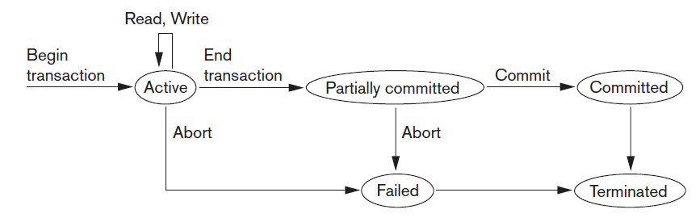
Transaction and System Concepts
Transaction States and Additional Operations

Slide 31
Transaction and System Concepts
Transaction States and Additional Operations
A transaction goes into an active state immediately after it starts execution, where it can execute its READ and WRITE operations.
When the transaction ends, it moves to the partially committed state.
At this point, some types of concurrency control protocols may do additional checks to see if the transaction can be committed or not.
If these checks are successful, the transaction is said to have reached its commit point and enters the committed state.
When a transaction is committed, it has concluded its execution successfully and all its changes must be recorded permanently in the database, even if a system failure occurs.
However, a transaction can go to the failed state if one of the checks fails or if the transaction is aborted during its active state.
The transaction may then have to be rolled back to undo the effect of its WRITE operations on the database.
The terminated state corresponds to the transaction leaving the system.

Slide 32
Transaction and System Concepts
The System Log
To be able to recover from failures that affect transactions, the system maintains a log to keep track of all transaction operations that affect the values of database items, as well as other transaction information that may be needed to permit recovery from failures.
The log is a append-only file that is kept on disk, so it is not affected by any type of failure except for disk failure.
Typically, one (or more) main memory buffers, called the log buffers, hold the last part of the log file, so that log entries are first added to the log main memory buffer.
When the log buffer is filled, the log buffer is appended to the end of the log file on disk.

Slide 33
Transaction and System Concepts
The System Log
The following are the types of entries called log records that are written to the log file.
T refers to a unique transaction-id that is generated automatically by the system for each transaction and that is used to identify each transaction:
[start_transaction, T] Indicates that transaction T has started execution.
[write_item, T, X, old_value, new_value] Indicates that transaction T has changed the value of database item X from old_value to new_value.
[read_item, T, X] Indicates that transaction T has read the value of database item X.
[commit, T] Indicates that transaction T has completed successfully, and affirms that its effect can be committed to the database.
[abort, T] Indicates that transaction T has been aborted.

Slide 34
Transaction and System Concepts
Commit Point of a Transaction
A transaction T reaches its commit point when:
all its operations that access the database have been executed successfully
and the effect of all the transaction operations on the database have been recorded in the log.
The transaction then writes a commit record [commit, T] into the log.
If a system failure occurs,
we can search back in the log for all transactions T that have written a [start_transaction, T] record into the log but have not written their [commit, T] record yet;
these transactions may have to be rolled back to undo their effect during the recovery process.

Slide 35
Desirable Properties of Transactions
The following are the ACID properties:
Atomicity: A transaction is an atomic unit of processing; it should either be performed in its entirety or not performed at all.
Consistency preservation: If a transaction is completely executed from beginning to end without interference from other transactions, it should take the database from one consistent state to another. A consistent state of the database satisfies the constraints specified in the schema.
Isolation: A transaction should appear as though it is being executed in isolation from other transactions, even though many transactions are executing concurrently. That is, the execution of a transaction should not be interfered with by any other transactions executing concurrently.
Durability or permanency: The changes applied to the database by a committed transaction must persist in the database. These changes must not be lost because of any failure.

Slide 36
Desirable Properties of Transactions
Levels of Isolation. There have been attempts to define the level of isolation of a transaction.
A transaction is said to have
Level 0 (zero) isolation
if it does not overwrite the dirty reads.
Level 1 (one) isolation
has no lost updates
Level 2 isolation
has no lost updates and no dirty reads.
Level 3 isolation (also called true isolation)
has, in addition to level 2 properties, no nonrepeatable reads.

Slide 37
Characterizing Schedules Based on Recoverability
Schedule:
When transactions are executing concurrently in an interleaved fashion, then the order of execution of operations from all the various transactions is known as a schedule (or history).
Schedules (Histories) of Transactions
A schedule (or history) S of n transactions T1, T2, … , Tn is an ordering of the operations of the transactions.
Operations from different transactions can be interleaved in the schedule S.

Slide 38
Characterizing Schedules Based on Recoverability
Schedules (Histories) of Transactions
A shorthand notation for describing a schedule uses the symbols
b: begin_transaction
r: read_item
w: write_item
e: end_transaction
c: commit
a: abort,
appends as a subscript the transaction id (transaction number) to each operation in the schedule.
For example: committing transaction 1 can be shown as: C₁
the database item X that is read or written follows the r and w operations in parentheses.
For example, transaction 1 reading an item X can be shown as: r₁(X)

Slide 39
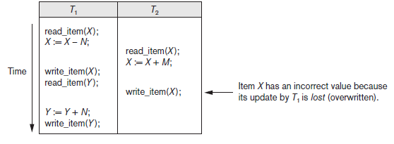
Characterizing Schedules Based on Recoverability
Schedules (Histories) of Transactions
The schedule shown in figure can be written as follows in this notation:
Sa: r₁(X); r₂(X); w₁(X); r₁(Y); w₂(X); w₁(Y);

Slide 40
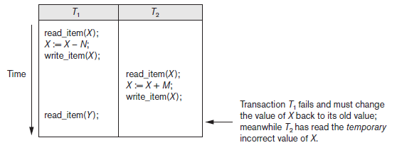
Characterizing Schedules Based on Recoverability
Schedules (Histories) of Transactions
Similarly, the schedule for Figure 20.3(b), which we call Sb, can be written as follows, if we assume that transaction T1 aborted after its read_item(Y) operation:
Sb: r₁(X); w₁(X); r₂(X); w₂(X); r₁(Y); a₁;

Slide 41
Characterizing Schedules Based on Recoverability
Schedules (Histories) of Transactions
Conflicting Operations in a Schedule.
Two operations in a schedule are said to conflict if they satisfy all three of the following conditions:
(1) they belong to different transactions;
(2) they access the same item X;
and (3) at least one of the operations is a write_item(X).

Slide 42
Characterizing Schedules Based on Recoverability
Schedules (Histories) of Transactions
Conflicting Operations in a Schedule.
the operations r1(X) and w2(X) conflict, as do the operations r2(X) and w1(X), and the operations w1(X) and w2(X).
The operations r1(X) and r2(X) do not conflict, since they are both read operations;
the operations w2(X) and w1(Y) do not conflict because they operate on distinct data items X and Y;
The operations r1(X) and w1(X) do not conflict because they belong to the same transaction.

Slide 43
Characterizing Schedules Based on Recoverability
Schedules (Histories) of Transactions
Conflicting Operations in a Schedule.
Precisely we can say that two operations are conflicting if changing their order of execution can result in a different outcome.
For example, if we change the order of the two operations r1(X);w2(X) to w2(X); r1(X), then the value of X that is read by transaction T1 changes, because in the second ordering the value of X is read by r1(X) after it is changed byw2(X), whereas in the first ordering the value is read before it is changed.
This is called a read-write conflict.

Slide 44
Characterizing Schedules Based on Recoverability
Schedules (Histories) of Transactions
Conflicting Operations in a Schedule.
The other type is called a write-write conflict and is illustrated by the case where we change the order of two operations such as w1(X); w2(X) to w2(X); w1(X).
For a write-write conflict, the last value of X will differ because in one case it is written by T2 and in the other case by T1.
Notice that two read operations are not conflicting because changing their order makes no difference in outcome.

Slide 45
Characterizing Schedules Based on Recoverability
Characterizing Schedules Based on Recoverability
types of schedules for which recovery is possible.
Once a transaction T is committed, it should never be necessary to roll back T.
This ensures that the durability property of transactions is not violated.
Now we will discuss the recoverable or non recoverable schedules.
Nonrecoverable schedules should not be permitted by the DBMS

Slide 46
Characterizing Schedules Based on Recoverability
Characterizing Schedules Based on Recoverability
Recoverable schedules
The schedules whose Recovery is possible
Which schedules are said to be recoverable?
A schedule S is recoverable if no transaction T in schedule S commits until all transactions T′ that have written some item X that T reads, have committed.
Cascading rollback:
An uncommitted transaction has to be rolled back because it read an item from a failed transaction.
Cascading rollback may occur in some recoverable schedules
Its time consuming as It may require multiple transactions to roll back

Slide 47
Characterizing Schedules Based on Recoverability
Characterizing Schedules Based on Recoverability
Is this schedule recoverable?
Sa′ is recoverable, even though it suffers from the lost update problem

Slide 48
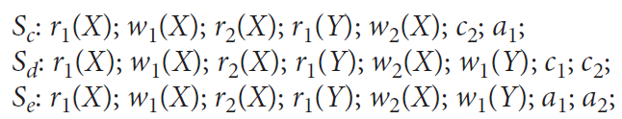
Characterizing Schedules Based on Recoverability
Characterizing Schedules Based on Recoverability
S_{c} is not recoverable because T2 reads item X from T1, but T2 commits before T1 commits.
The problem occurs if T1 aborts after the c2 operation in Sc;
then the value of X that T2 read is no longer valid and T2 must be aborted after it is committed,
leading to a schedule that is not recoverable.
Solution for recovering S_{c}:
For the schedule to be recoverable, the c2 operation in Sc must be postponed until after T1 commits, as shown in Sd.

Slide 49
Characterizing Schedules Based on Recoverability
Characterizing Schedules Based on Recoverability
For S_{e}:
If T1 aborts instead of committing, then T2 should also abort as shown in S_{e}, because the value of X it read is no longer valid.
In Se, aborting T2 is acceptable since it has not committed yet, hence the schedule is recoverable schedule.

Slide 50
Characterizing Schedules Based on Recoverability
Characterizing Schedules Based on Recoverability
cascading rollback (or cascading abort) may occur in some recoverable schedules in which an uncommitted transaction has to be rolled back because it read an item from a transaction that failed.
Hence schedule S_{e} depicts cascading rollback phenomenon,
where transaction T2 has to be rolled back because it read item X from T1, and T1 then aborted.

Slide 51
Characterizing Schedules Based on Recoverability
Characterizing Schedules Based on Recoverability
Cascadeless schedules
Used to avoid cascading rollback
How?
every transaction in the schedule reads only items that were written by committed transactions.
Advantage:
Save time
Since a data is read from an already committed transaction so the data will always be valid

Slide 52
Characterizing Schedules Based on Recoverability
Characterizing Schedules Based on Recoverability
Strict schedule:
A schedule in which transactions can neither read nor write an item X until the last transaction that wrote X has committed (or aborted).

Slide 53
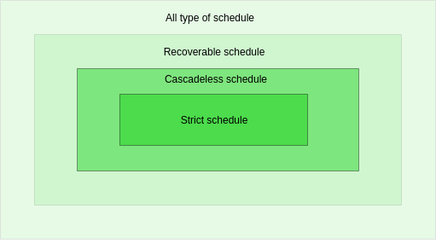
Characterizing Schedules Based on Recoverability
Characterizing Schedules Based on Recoverability
we can divide the schedules into two disjoint subsets:
recoverable
nonrecoverable.
The cascadeless schedules will be a subset of the recoverable schedules,
the strict schedules will be a subset of the cascadeless schedules.
Thus,
all strict schedules are cascadeless,
and all cascadeless schedules are recoverable.

Slide 54
Characterizing Schedules Based on Serializability
Serializable schedules:
If no interleaving of operations is permitted, there are only two possible outcomes:
Execute all the operations of transaction T1 (in sequence) followed by all the operations of transaction T2 (in sequence).
T₁ -> T₂
Execute all the operations of transaction T2 (in sequence) followed by all the operations of transaction T1 (in sequence).
T₂ -> T₁

Slide 55
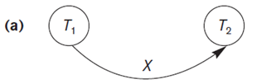
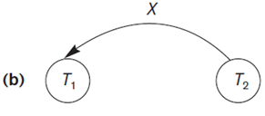
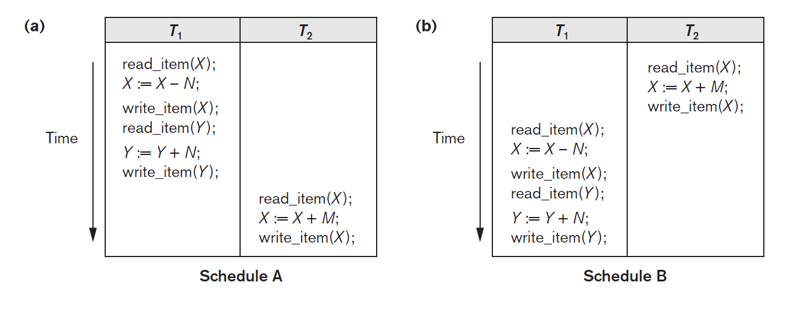
Characterizing Schedules Based on Serializability
Serial, Non-serial, and Conflict-Serializable Schedules
Schedules A and B are called serial because the operations of each transaction are executed consecutively, without any interleaved operations from the other transaction.

Slide 56
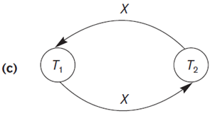
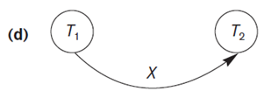
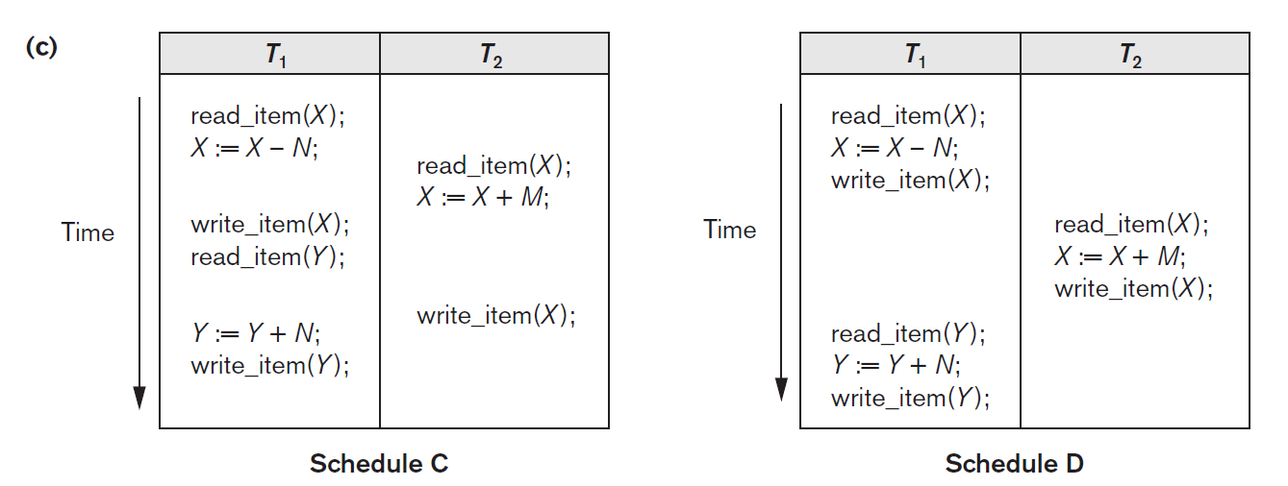
Characterizing Schedules Based on Serializability
Serial, Non-serial, and Conflict-Serializable Schedules
Schedules C and D are called non-serial because each sequence interleaves operations from the two transactions.

Slide 57
Characterizing Schedules Based on Serializability
Serial, Non-serial, and Conflict-Serializable Schedules
Problem with serial schedules:
two transactions cannot run concurrently.
Thus, if a transaction waits for an I/O operation to complete, we cannot switch the CPU processor to another transaction,
which results in wasting valuable CPU processing time.
Hence, serial schedules are unacceptable in practice.

Slide 58
Characterizing Schedules Based on Serializability
Serial, Non-serial, and Conflict-Serializable Schedules
Serializable schedule:
if a non-serial schedule and a serial schedule result in the same output
then it is termed as a serializable schedule.

Slide 59
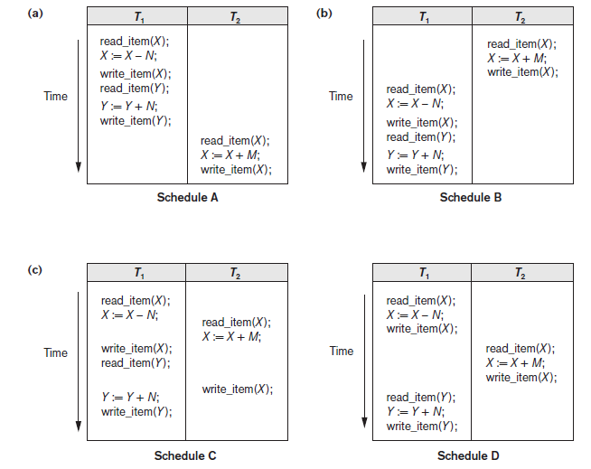
Characterizing Schedules Based on Serializability
Serial, Non-serial, and Conflict-Serializable Schedules
Let, Initial values:
X = 90, Y = 90, N = 3, M = 2.
Expected Outcome after execution:
X = 89, Y = 93.
Output of Schedule C
X = 92, Y = 93
X value is erroneous because of the lost update problem
Output of Schedule D
X = 89 and Y = 93.

Slide 60
Characterizing Schedules Based on Serializability
Serial, Non-serial, and Conflict-Serializable Schedules
So, Some non-serial schedules give the correct expected result, such as schedule D.
We just need to identify that which of the non-serial schedules always give a correct result and which may give erroneous results.
Serializability:
determine which non-serial schedules are equivalent to a serial schedule and allow those to occur only

Slide 61
Characterizing Schedules Based on Serializability
Conflict equivalence
Relative order of any two conflicting operations is the same in both schedules
When swapping the position of operations makes no difference on the execution of two schedules
Remember what are the conflicting operations
Conflict Serializable schedules
Schedule S is serializable if it is conflict equivalent to some serial schedule S’.

Slide 62
Characterizing Schedules Based on Serializability
Testing for Serializability of a Schedule
There is a simple algorithm for determining whether a particular schedule is (conflict) serializable or not.
Look for read_item and write_item operations in a schedule
construct a precedence graph (or serialization graph) using those operations,
The graph should be a directed graph.

Slide 63
Characterizing Schedules Based on Serializability
Testing for Serializability of a Schedule
Algorithm : Testing Conflict Serializability of a Schedule S
For each transaction Ti participating in schedule S, create a node labeled Ti in the precedence graph.
For each case in S where Tj executes a read_item(X) after Ti executes a write_item(X), create an edge (Ti → Tj) in the precedence graph.
For each case in S where Tj executes a write_item(X) after Ti executes a read_item(X), create an edge (Ti → Tj) in the precedence graph.
For each case in S where Tj executes a write_item(X) after Ti executes a write_item(X), create an edge (Ti → Tj) in the precedence graph.
The schedule S is serializable if and only if the precedence graph has no cycles.

Slide 64
Characterizing Schedules Based on Serializability
Testing for Serializability of a Schedule
If there is a cycle in the precedence graph, schedule S is not (conflict) serializable;
The name is conflict serializable as we check for Read write conflicts in the trasactions
Three conflicting pairs are:
R-W
W-R
W-W
if there is no cycle, S is serializable
After that check for its equivalent serial schedule

Slide 65
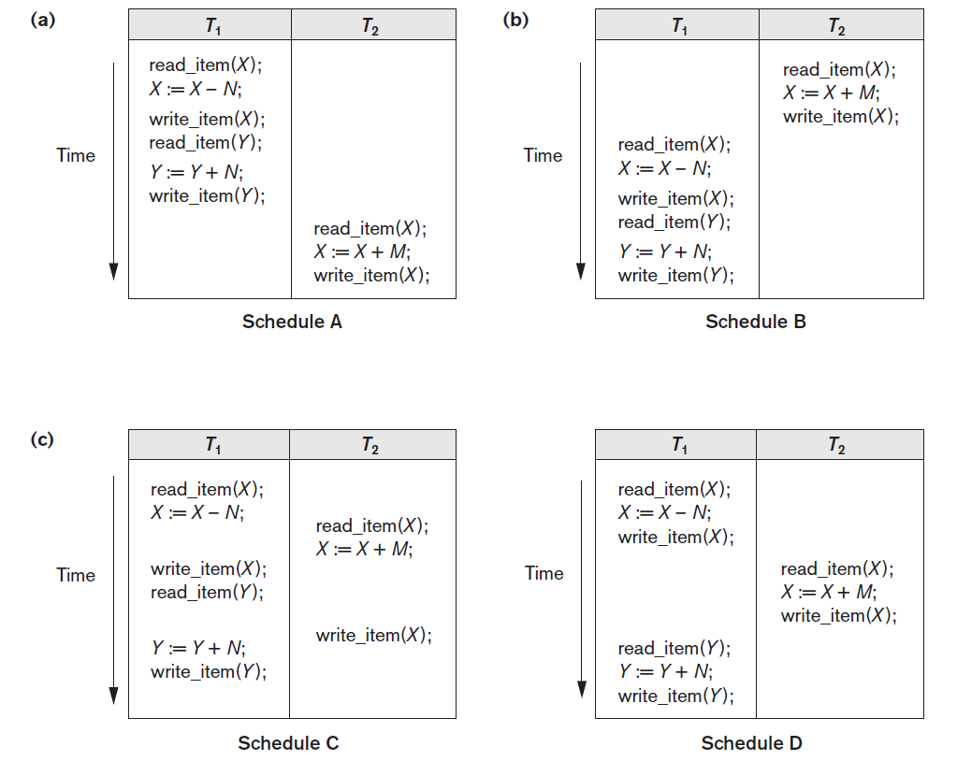
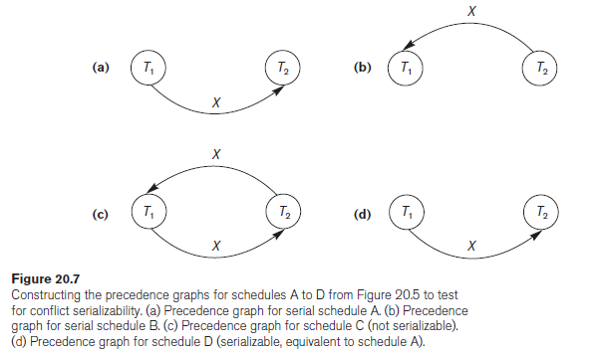
Characterizing Schedules Based on Serializability
Testing for Serializability of a Schedule

Slide 66
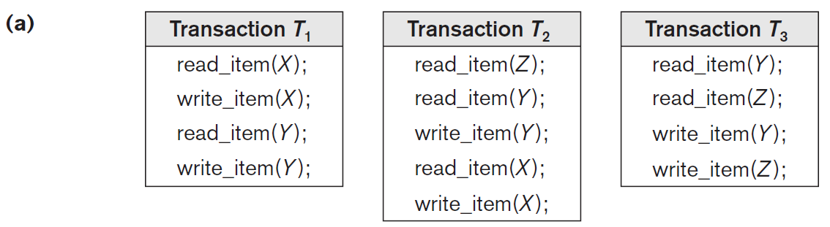
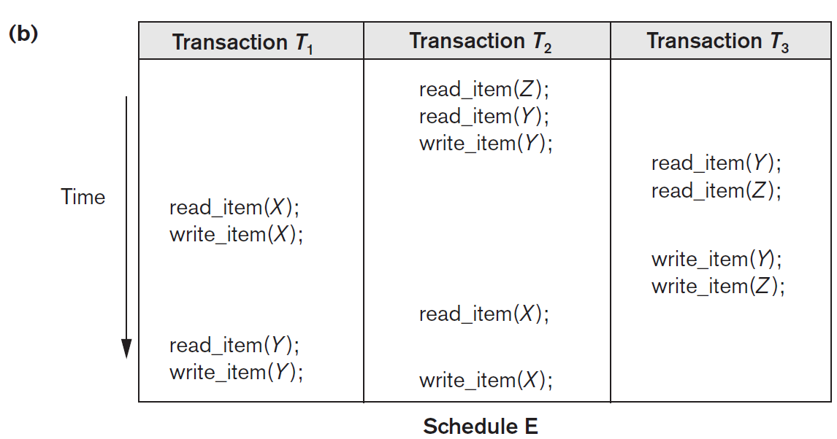
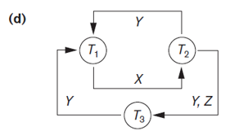

Slide 67
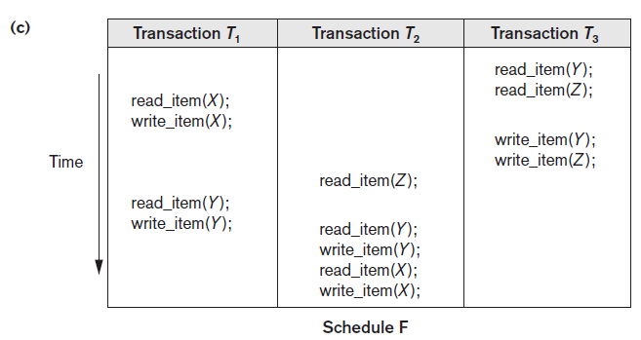
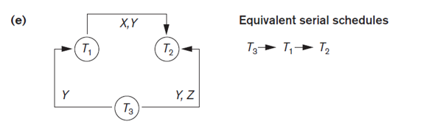

Slide 68
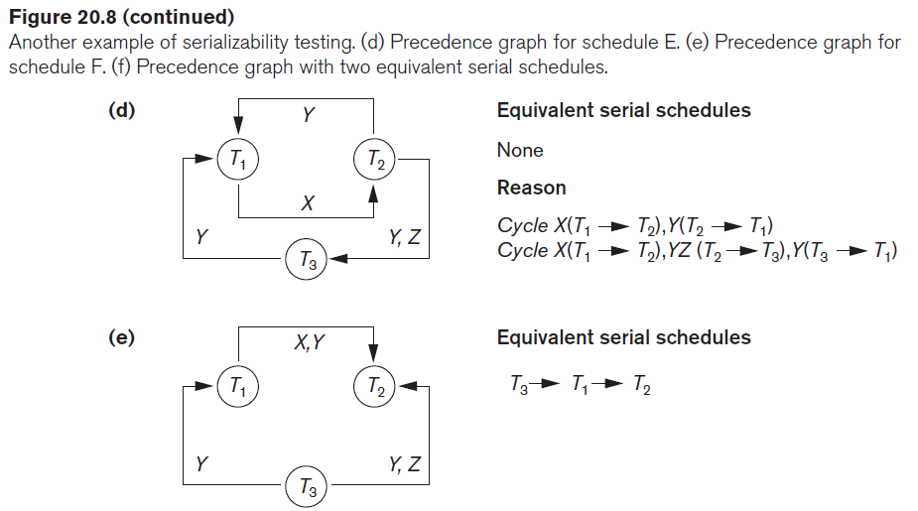
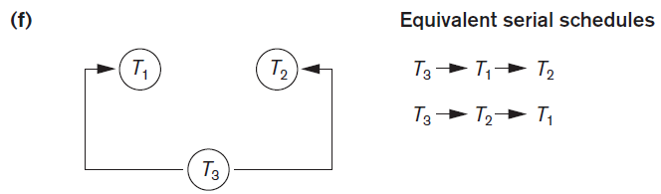

Slide 69
Characterizing Schedules Based on Serializability
Testing for Serializability of a Schedule
Being serializable is different from being serial
Difficult to test for serializability in practice
Factors such as system load, time of transaction submission, and process priority affect ordering of operations
Difficult to ensure which set of operations should be scheduled concurrently.

Slide 70
Characterizing Schedules Based on Serializability
Testing for Serializability of a Schedule
If transactions are executed concurrently and then checked for serializability, a problem occur i.e. the result might not be correct and hence the effect of schedule needs to be cancelled.
DBMS enforces protocols
Set of rules to ensure serializability
We will discuss some concurrency control protocols that ensures serializability based on
locking data items
Snapshot isolation
Timestamp ordering etc.

Slide 71
Characterizing Schedules Based on Serializability
Testing for Serializability of a Schedule
View Equivalence and View Serializability
Two schedules S and S′ are said to be view equivalent if the following three conditions hold:
For each data item:
First read should be performed by same transaction
If T₁ is performing R(X) in S then, T₁ should also perform R(X) in S′
Last write should be performed by same transaction
Producer consumer sequence should be maintained

Slide 72
Characterizing Schedules Based on Serializability
Testing for Serializability of a Schedule
View Equivalence and View Serializability
Check for view equivalence
Check all 3 rules w.r.t each data item
T1 | T2
R(X)
W(X)
 | R(X)
 | W(X)
R(Y)
W(Y)
 | R(Y)
 | W(Y)
T1 | T2
R(X)
W(X)
R(Y)
W(Y)
 | R(X)
 | W(X)
 | R(Y)
 | W(Y)

Slide 73
Characterizing Schedules Based on Serializability
Testing for Serializability of a Schedule
View Equivalence and View Serializability
Why View Serializability is needed?
Conflict serializability does not care about the data operations performed.
It just works as per some rules
Whereas, view serializability restricts the order of execution of operations on data items
view serializable Schedule:
if a schedule is view equivalent to a serial schedule.

Slide 74


Characterizing Schedules Based on Serializability
Testing for Serializability of a Schedule
View Equivalence and View Serializability
A blind write is a write operation in a transaction T on an item X which was not read any where before in the transaction T.
For example, Consider the following schedule
T1 | T2 | T3
R(X)
 | W(X)
W(X)
 |  | W(X)
COMMIT
 | COMMIT
 |  | COMMIT
Blind write

Slide 75
Characterizing Schedules Based on Serializability
Testing for Serializability of a Schedule
View Equivalence and View Serializability
The schedule is view serializable, since it is view equivalent to the serial schedule T1->T2 ->T3
T1 | T2 | T3
R(X)
 | W(X)
W(X)
 |  | W(X)
COMMIT
 | COMMIT
 |  | COMMIT
T1 | T2 | T3
R(X)
W(X)
COMMIT
 | W(X)
 | COMMIT
 |  | W(X)
 |  | COMMIT

Slide 76

Characterizing Schedules Based on Serializability
Testing for Serializability of a Schedule
View Equivalence and View Serializability
However, it is not conflict serializable, since it is not conflict equivalent to any serial schedule.
Any conflict-serializable schedule is also view serializable but not vice versa.
x
T₁
T₂
x
x
x
T₃

Slide 77
Characterizing Schedules Based on Serializability
Conflict serializable
Check for blind write
View serializable
Not View serializable
S is view serializable
No
Yes
Yes
No

Slide 78
Transaction Support in SQL
SQL does not have any implicit begin_transaction statement
However, every transaction must have an explicit end statement,
which is either a COMMIT or a ROLLBACK.
Every transaction has certain characteristics.
These characteristics are: Access mode, diagnostic area size, isolation level
These characteristics are specified using SET TRANSACTION statement in SQL.
The access mode can be specified as READ ONLY or READ WRITE.
READ WRITE mode (default)
allows select, update, insert, delete, and create commands to be executed.
READ ONLY mode
allows data retrieval operations only.
The diagnostic area size, an integer value
Represents number of conditions held simultaneously in diagnostic area.
Statement information such as the number of rows affected by a statement.
Condition information such as error code for the error occurred while executing the statement and its Error message.

Slide 79
Transaction Support in SQL
If a transaction executes at a lower isolation level than SERIALIZABLE, then one or more of the following three violations may occur:
Dirty read
A transaction T1 may read the update of a transaction T2, which has not yet committed.
If T2 fails and is aborted, then T1 would have read a value that does not exist and is incorrect.
T1 | T2
W(X)
 | R(x)

Slide 80
Transaction Support in SQL
Nonrepeatable read:
A transaction T1 may read a given value.
If another transaction T2 later updates that value
Now, T1 reads that value again,
T1 will see a different value.
T1 | T2
R(X)
 | R(x)
 | W(X)
R(X)

Slide 81
Transaction Support in SQL
Phantoms:
A transaction T1 may read a set of rows from a table, perhaps based on some condition specified in the SQL WHERE-clause.
Now suppose that a transaction T2 inserts a new row r that also satisfies the WHERE-clause condition used in T1, into the table used by T1.
The record r is called a phantom record because it was not there when T1 starts but is there when T1 ends.
Solution: If the equivalent serial order is T2->T1, then the record r should not be seen; but if it is T2 followed by T1,then the phantom record should be in the result given to T1.

Slide 82
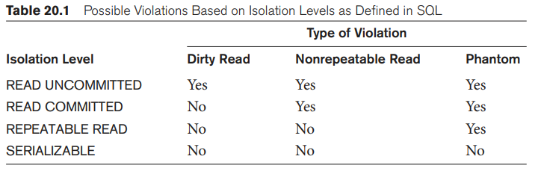
Transaction Support in SQL
Hence, isolation level SERIALIZABLE is used as it’s the most restrictive one.

Slide 83
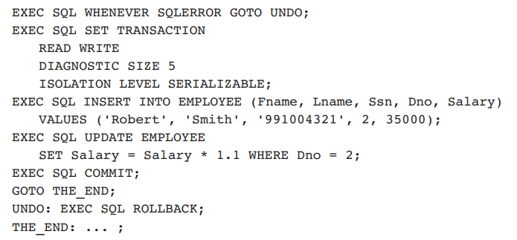
Transaction Support in SQL
SQL statements insert a new row and then update the salaries of the employees working in department number 2

